Slide 1

Numpy, Pandas, Visualization - Part 4
Pandas DataFrame, Reading Data From Various Files

Slide 2
Pandas DataFrame - Introduction

Slide 3
Introduction
A DataFrame is two dimensional data structure where the data is arranged in the tabular format in rows and columns
DataFrame features:
Columns can be of different data types
Size of dataframe can be changes
Axes(rows and columns) are labeled
Arithmetic operations can be performed on rows and columns

Slide 4
DataFrame Creation

Slide 5
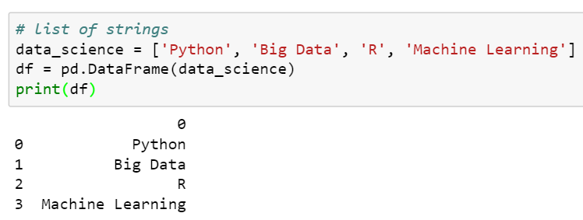
Creating a DataFrame
Creating a dataframe from a list
Pass a list as a column in ‘df’
As no column name is passed, by default it returns ‘0’ as column name

Slide 6
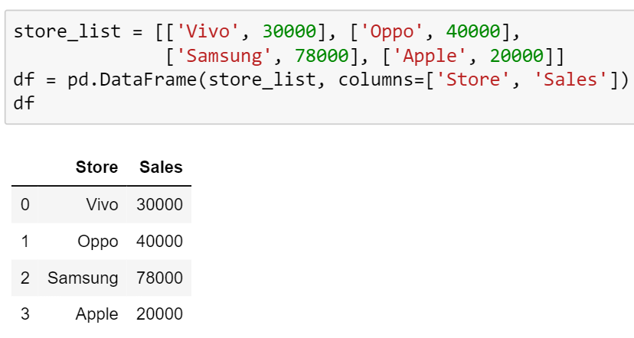
Creating a DataFrame
Creating a dataframe from a list of list
Pass the list of column names

Slide 7
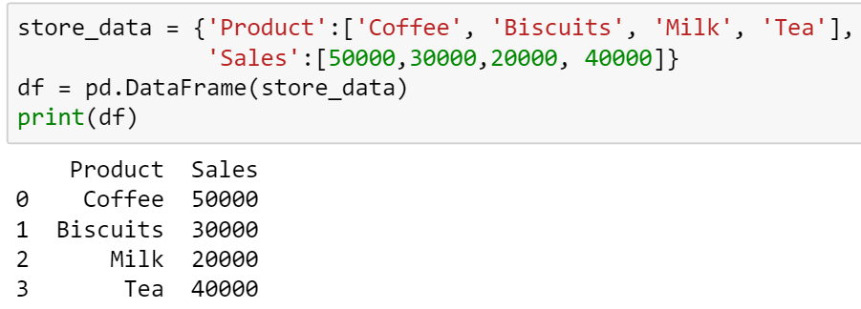
Creating a DataFrame
Creating a dataframe from dictionary
Keys of the dictionary as column names

Slide 8
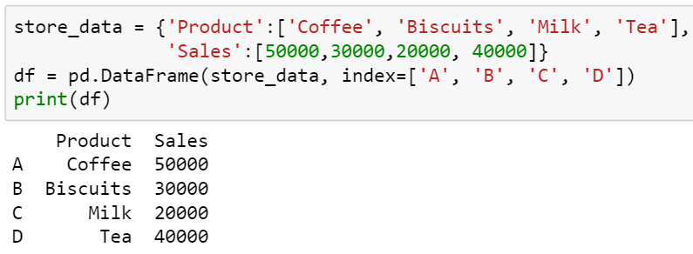
Creating a DataFrame
Creating a dataframe with index from dictionary
Pass a list of index

Slide 9
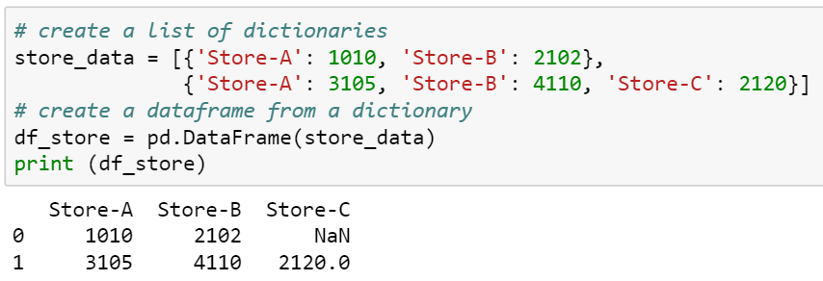
Creating a DataFrame
Creating a dataframe from a list of dictionaries
Dictionary as a row

Slide 10
Reading Data from Various Files

Slide 11
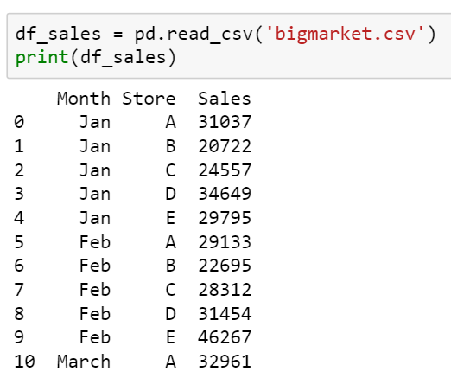
Reading data from csv file
Use the pandas read_csv() method to read the data from a csv file

Slide 12
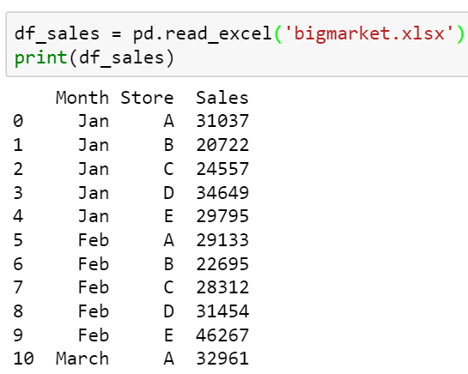
Reading data from xlsx file
Use the pandas read_excel() method to read the data from xlsx file

Slide 13
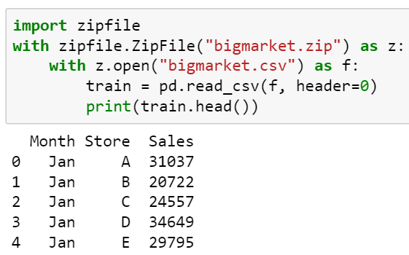
Reading data from zip file
If you have a csv file inside a zip file:
Read the zip file
Open csv file inside the zip file
Read the csv file

Slide 14
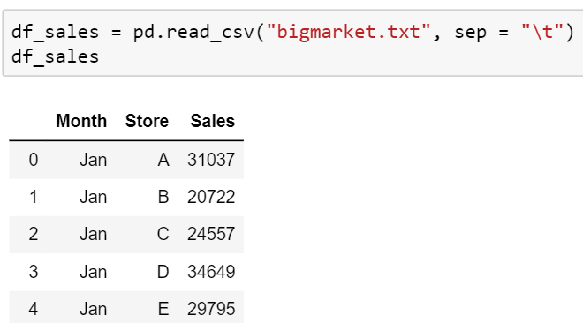
Reading data from text file
You can the pandas read_csv() method to read the data from text file

Slide 15
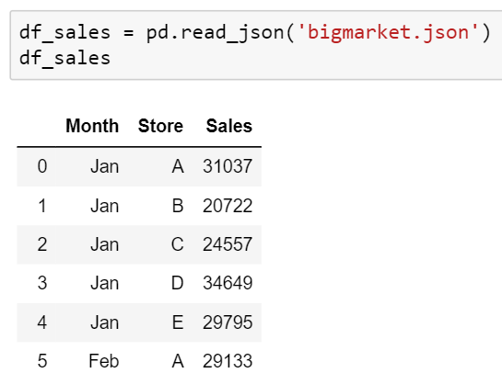
Reading data from json file
Use the pandas read_json() method to read the data from json file

Slide 16
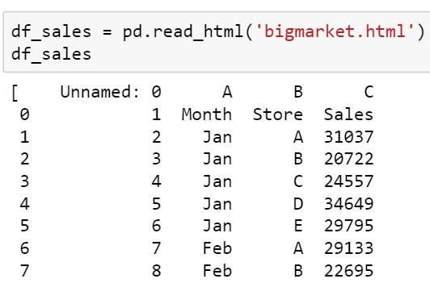
Reading data from html file
Use the pandas read_html() method to read the data from html file

Slide 17
Understanding Data

Slide 18
Read the data from xlsx file
We use the following DataFrame for the study

Slide 19
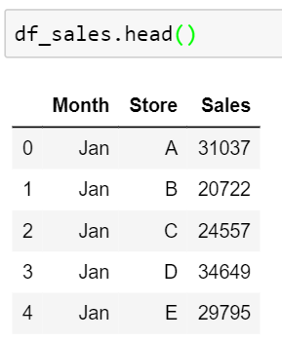
Display the top five rows
The pandas head() method displays the first five rows of the data

Slide 20
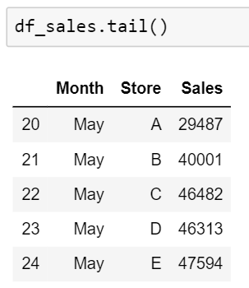
Display the bottom five rows
The pandas tail() method displays the last five rows of the data

Slide 21
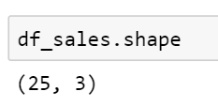
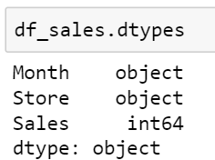
Understanding data
Get the number of observations and number of columns of the data using the shape attribute
Get the data type of each variable in the data using the dtypes attribute

Slide 22
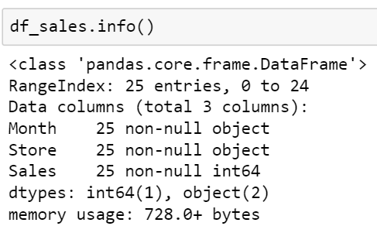
Understanding data
The pandas info() method prints the information about the shape, data type and null values in the data
Here, ‘df_sales’ has 3 variables with 25 non-null observations in each
Of all the three variables, two are categorical (‘Month’ and ‘Store’) and one is numeric (Sales)

Slide 23
THANK YOU
Presenter’s Name
Contact Us
support@knowledgehut.com
Presenter’s Designation

